Slide 1
Voltage/VAR Control and Optimization in Distribution Systems
EE 653 Power distribution system modeling, optimization and simulation
Dr. Zhaoyu Wang
Department of Electrical and Computer Engineering
Iowa State University
wzy@iastate.edu

Slide 2
Contents
Introduction of Voltage/VAR Control (VVC)
The concept of VVC
VVC devices
Control Architecture of VVC
Decentralized (local) VVC
Centralized VVC
Hierarchical VVC
Voltage/VAR optimization (VVO)
Conservation voltage reduction (CVR)
Literature Review
Model predictive control (MPC)-based VVO (centralized, w/o PV inverter)
Multi-stage VVO (hierarchical, w/ PV inverter)

Slide 3
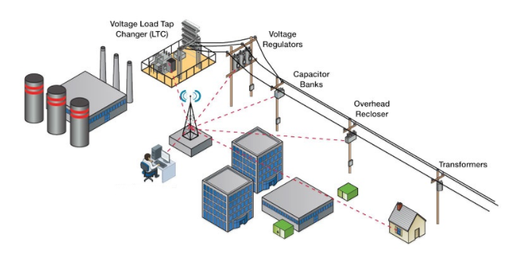
The concept of VVC
Volt/VAR control (VVC) refers to the process of managing voltage levels and reactive power (VAR) throughout the distribution systems.
VVC can improve voltage profiles for all end-use customers and achieve multiple objectives, such as real power losses and voltage deviation.
Fig. 1 VVC Application Demonstration [1]
[1] Office of Electricity Delivery and Energy Reliability, “Voltage and VAR Control Impact Analysis Approach”, U.S. Department of Energy, [online]: https://www.smartgrid.gov/files/Distribution_System_Energy_Efficiency_17Nov11.pdf

Slide 4
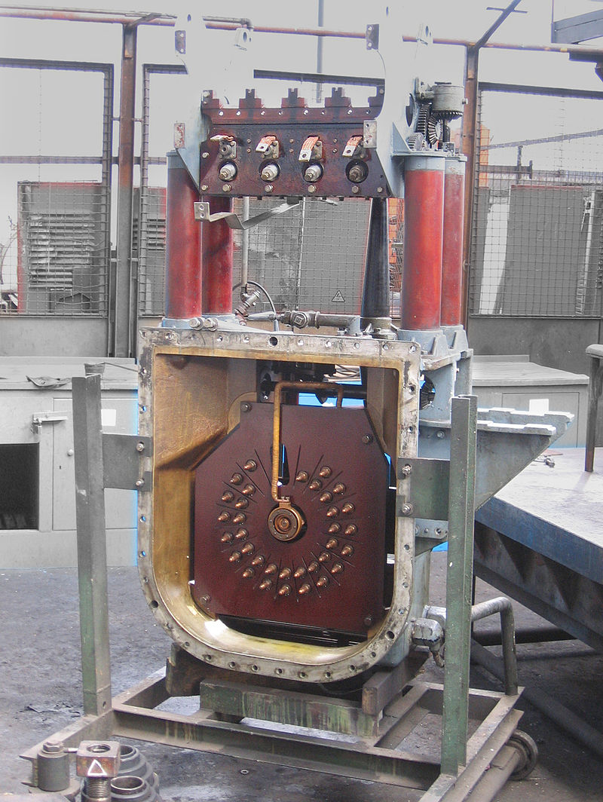
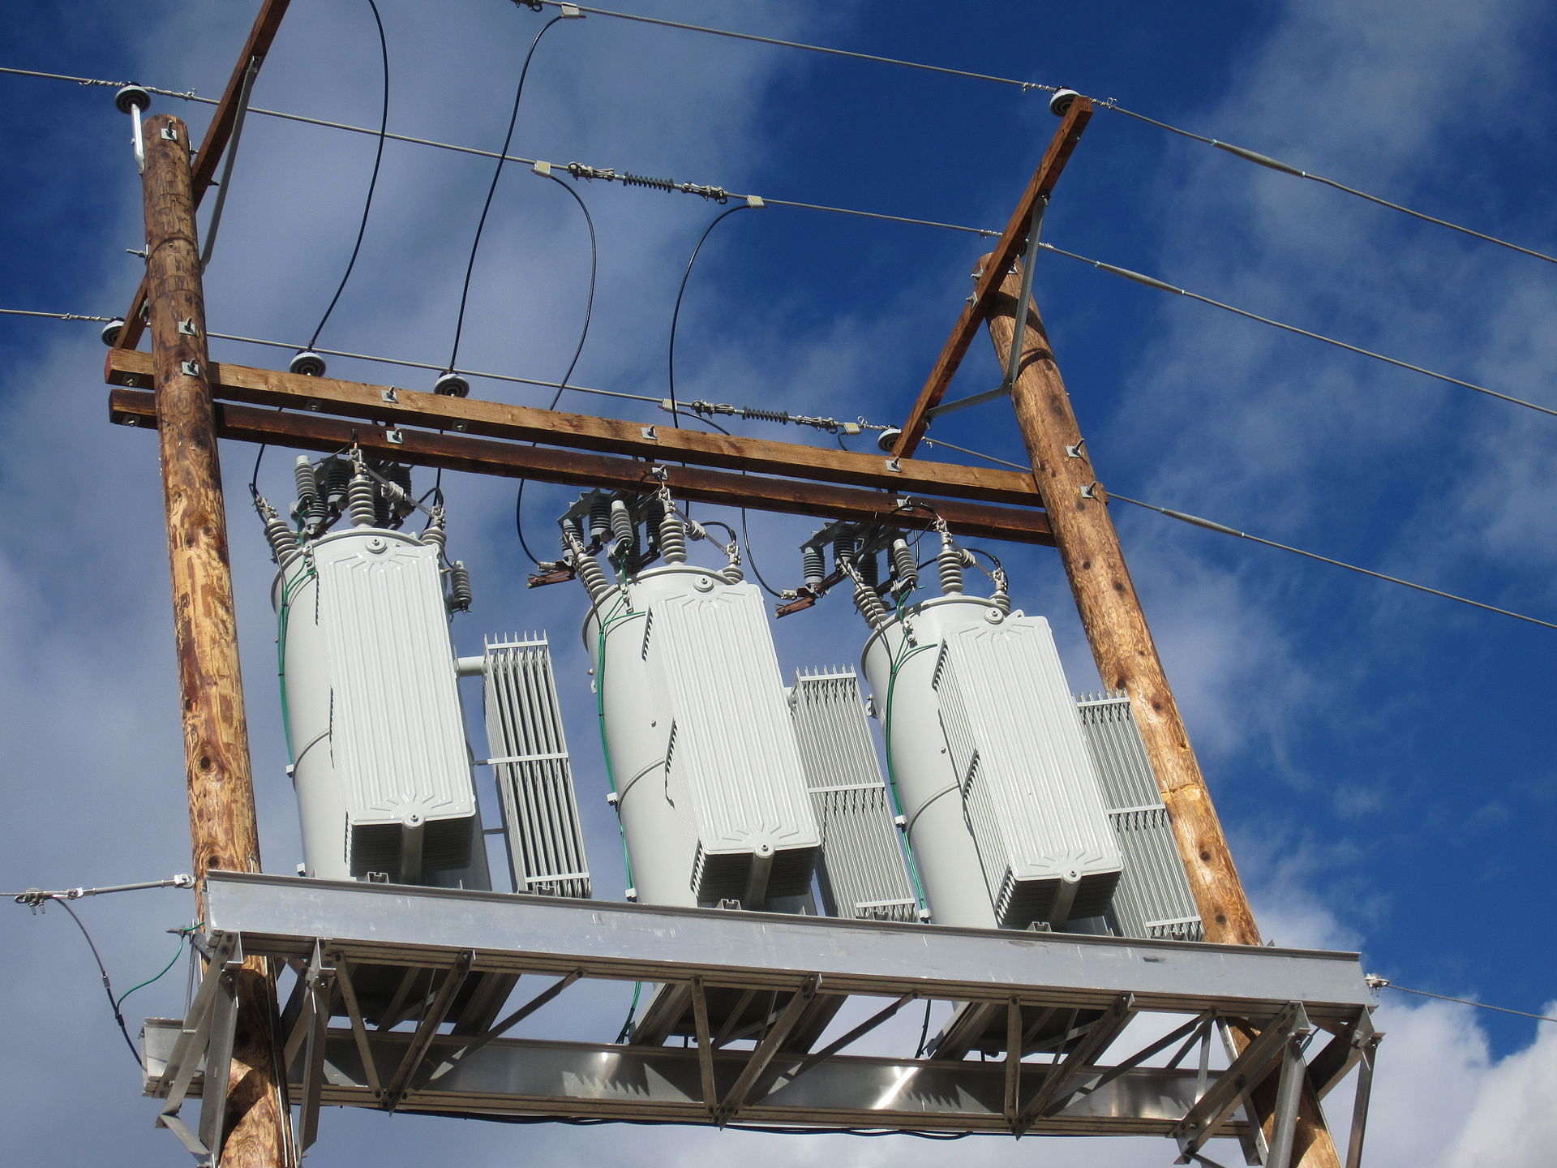
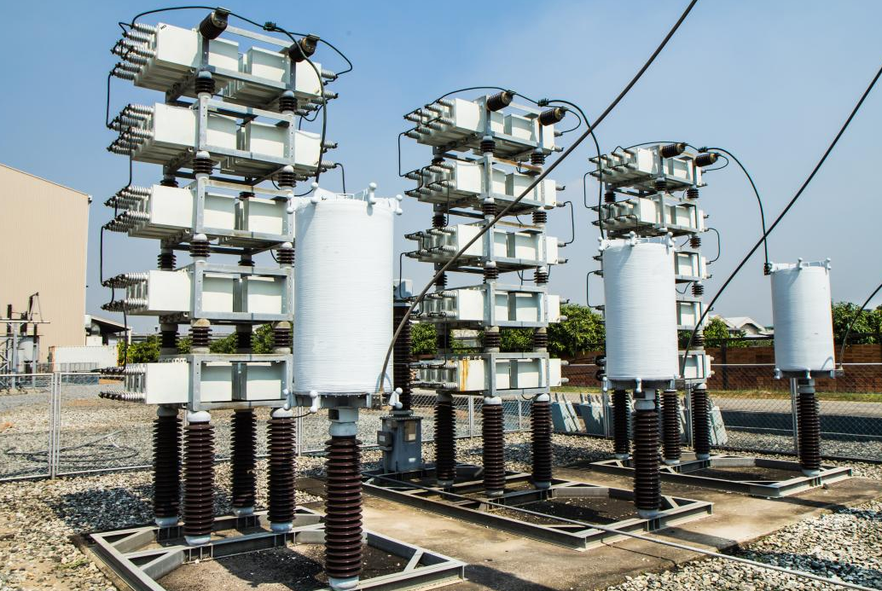
VVC Devices
Conventionally, there are three devices for carrying out voltage management:
Substation Transformers with Load tap changer (LTC)
In-line voltage regulators
Capacitor banks (CBs)
Tap changer inside a transformer
Three-phase voltage regulator
Capacitor bank
[1] Office of Electricity Delivery and Energy Reliability, “Voltage and VAR Control Impact Analysis Approach”, U.S. Department of Energy, [online]: https://www.smartgrid.gov/files/Distribution_System_Energy_Efficiency_17Nov11.pdf

Slide 5
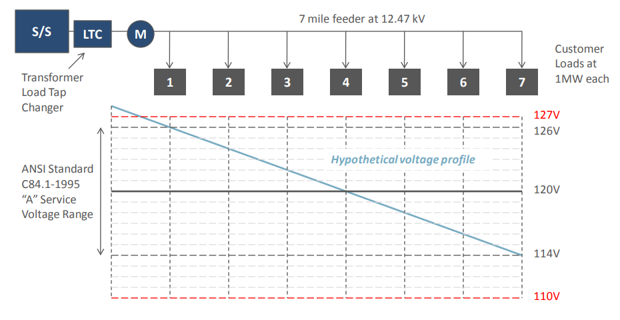
Basic Voltage Regulation with an LTC
Line voltage drops from the LTC at the head of the distribution line to customers farther out on the line [1].
[1] Office of Electricity Delivery and Energy Reliability, “Voltage and VAR Control Impact Analysis Approach”, U.S. Department of Energy, [online]: https://www.smartgrid.gov/files/Distribution_System_Energy_Efficiency_17Nov11.pdf

Slide 6
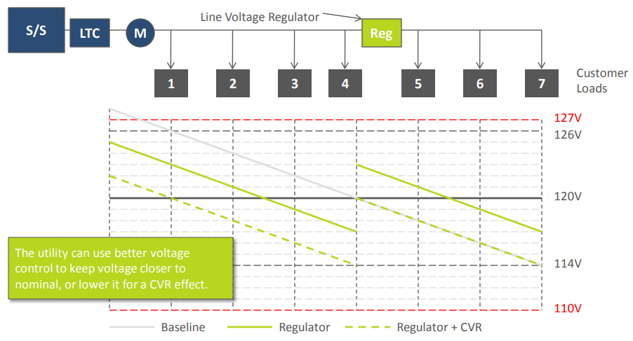
Coordinated LTC and Voltage Regulator
A voltage regulator can boost (raise) or buck (lower) voltage at a point on the distribution line and regulate down-line voltage [1].
[1] Office of Electricity Delivery and Energy Reliability, “Voltage and VAR Control Impact Analysis Approach”, U.S. Department of Energy, [online]: https://www.smartgrid.gov/files/Distribution_System_Energy_Efficiency_17Nov11.pdf

Slide 7
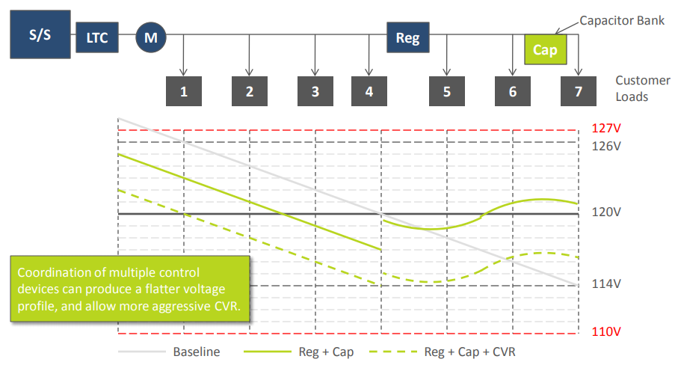
Coordinated LTC, Regulator and Capacitor Bank
A CB can help regulation by compensating for the lagging power factor of load and the line itself [1].
[1] Office of Electricity Delivery and Energy Reliability, “Voltage and VAR Control Impact Analysis Approach”, U.S. Department of Energy, [online]: https://www.smartgrid.gov/files/Distribution_System_Energy_Efficiency_17Nov11.pdf

Slide 8
Conventional and Emerging VVC Devices
Conventional VVC devices
Transformers with LTC
Cap banks
Volt regulators
Mechanical devices, slow, discrete changes, time delays between two changes, easy to control, not many in a feeder
Emerging VVC devices
Smart inverters
Continuous output, fast/instantaneous, capacity limits, numerous in a feeder

Slide 9
VVC and Smart Inverters
Traditionally, distributed solar photovoltaics (PV) systems were installed with standard inverters that only output active power.
Recently, however, PV is increasingly be paired with smart inverters that can also supply or absorb reactive power [2].
With this ability to provide reactive power, distributed PV has the potential to support and actively regulate local voltage and power factor on the grid.
This local smart inverter control can be done through various smart inverter modes, which include fixed power factor configuration or autonomously controlling the reactive power output based on the local voltage.
[2] Ding, Fei, et al. Photovoltaic impact assessment of smart inverter volt-var control on distribution system conservation voltage reduction and power quality. No. NREL/TP-5D00-67296. National Renewable Energy Lab.(NREL), Golden, CO (United States), 2016.

Slide 10
Control Architecture of VVC
According to the control architecture, the VVC method can be classified into three categories:
Decentralized (local) VVC
Centralized VVC
Hierarchical VVC
Fig. 1 VVC architecture: (a) Decentralized VVC; (b) Centralized VVC; (c) Hierarchical VVC [3]
[3] Q. Li, Y. Zhang, T. Ji, X. Lin and Z. Cai, "Volt/Var Control for Power Grids With Connections of Large-Scale Wind Farms: A Review," in IEEE Access, vol. 6, pp. 26675-26692, 2018.

Slide 11
Decentralized VVC
Decentralized VVC [3]:
Local Volt/VAR controllers receive local or partial information of power system states;
Decide the control decisions of the local devices for VVC.
For example, the control inputs can include voltage references of PV buses, reactive power output references of PQ buses and control instructions of reactive power compensators
It is worth mentioning that researchers are paying attention to distributed VVC. Similar to decentralized VVC, the control decisions are made by local volt/var controllers in distributed VVC.
* The difference between decentralized VVC and distributed VVC:
each local VVC controller in distributed VVC can exchange information with the other local controllers,
while the VVC controllers in decentralized VVC can only receive information.
[3] Q. Li, Y. Zhang, T. Ji, X. Lin and Z. Cai, "Volt/Var Control for Power Grids With Connections of Large-Scale Wind Farms: A Review," in IEEE Access, vol. 6, pp. 26675-26692, 2018.

Slide 12
Decentralized VVC
Advantages:
Simple and easy to implement
Does not require complicated computation and system-wide communication
Disadvantages:
Cannot consider the intermittent and fluctuating output of DERs for VVC from a system-wide perspective
Hard to achieve an optimal control due to lack of full observation of system states and lack of information exchange between local controllers
Application:
Simple VVC when computation and communication capability in the power system is low
Challenge:
How to achieve system-wide optimization with partial or local information of power system states
[3] Q. Li, Y. Zhang, T. Ji, X. Lin and Z. Cai, "Volt/Var Control for Power Grids With Connections of Large-Scale Wind Farms: A Review," in IEEE Access, vol. 6, pp. 26675-26692, 2018.

Slide 13
Centralized VVC
Centralized VVC [3]:
A central controller receives all the information of power system states.
Then decides and send back the control inputs of all the devices for VVC in the system.
Advantages:
Can achieve a system-wide optimization
Can cope with various challenges presented by DERs to VVC from a system-wide perspective
Disadvantages:
Requires high capacity of computation and communication
Inflexible to coordinate different device characteristics
Application:
System-wide optimal reactive power dispatch, when the computation and communication capacity in the power system is sufficient high
The central controller can obtain whole information of system states and control all available VVC devices
[3] Q. Li, Y. Zhang, T. Ji, X. Lin and Z. Cai, "Volt/Var Control for Power Grids With Connections of Large-Scale Wind Farms: A Review," in IEEE Access, vol. 6, pp. 26675-26692, 2018.

Slide 14
Hierarchical VVC
Hierarchical VVC [3]:
Multiple Volt/VAR controllers are organized in a hierarchical structure.
All the controllers can receive partial or all the information of power system states.
The controller at a lower layer complies with the decision made by the controller at the upper layer.
There are usually two ways to realize the hierarchical VVC :
The controller at the lower layer adjusts its control inputs at a high frequency while the controller at the upper layer does it at a low frequency.
The controller at the lower layer fulfills the requirements received from the controller at the upper layer and sends necessary information to the controller at the upper layer.
[3] Q. Li, Y. Zhang, T. Ji, X. Lin and Z. Cai, "Volt/Var Control for Power Grids With Connections of Large-Scale Wind Farms: A Review," in IEEE Access, vol. 6, pp. 26675-26692, 2018.

Slide 15
Hierarchical VVC
Advantages:
Has all advantage of centralized VVC
Flexible to coordinate different device characteristic
Disadvantages:
Requires high capacity of computation and communication
Complicated to design and implement
Application:
System-wide optimal reactive power dispatch considering coordination of different regulation characteristic between discrete devices and continuous device, when the computation and communication capacity in the power system is sufficiently high
Challenge:
How to improve calculation efficiency for optimal reactive power dispatch in large-scale power system with uncertain DERs
How to design the coordination of controllers at different layers
[3] Q. Li, Y. Zhang, T. Ji, X. Lin and Z. Cai, "Volt/Var Control for Power Grids With Connections of Large-Scale Wind Farms: A Review," in IEEE Access, vol. 6, pp. 26675-26692, 2018.

Slide 16
Volt/VAR Optimization Model
Volt/VAR optimization (VVO) is an advanced function, which coordinates VVC devices to achieve the utility’s operational objectives :
Minimization of power/energy losses
Minimization of voltage deviation
Minimization of peak load
Minimization of switching operations of VVC devices
…
Subject to the operating constraints of system and devices
Real and reactive power balance
Real and reactive line flow limits
Bus voltage limits
Device operating constraints
CB switching on/off limits
LTC tap position changing limits
Inverter (reactive) power output limits
…

Slide 17
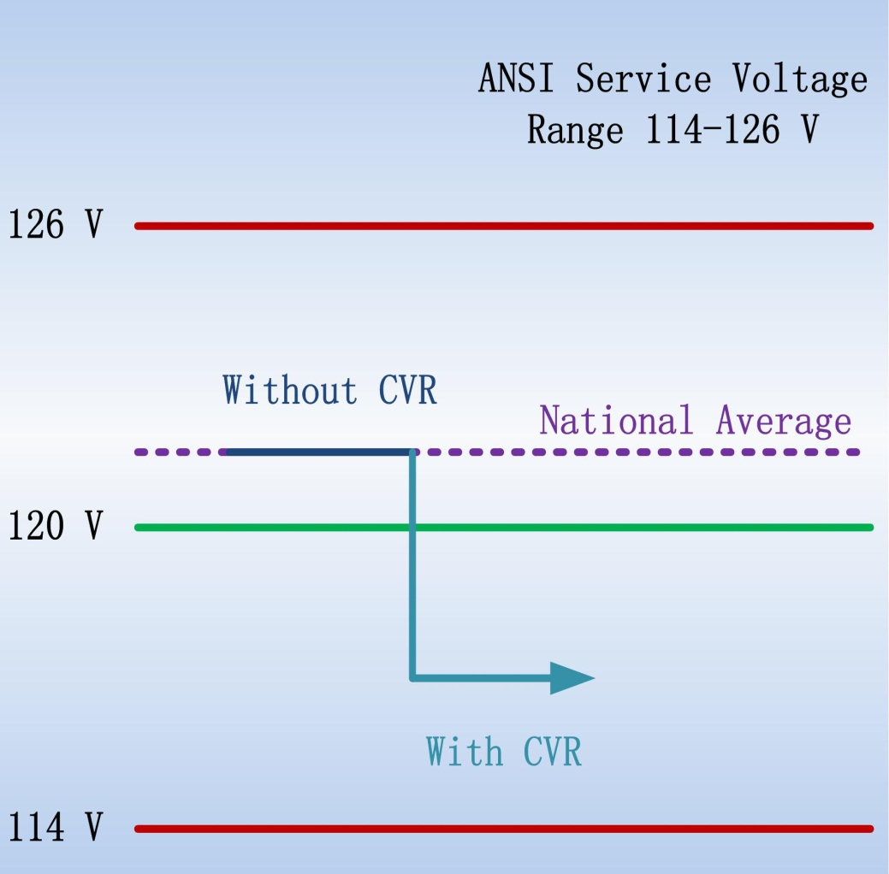
Conservation Voltage Reduction
Conservation voltage reduction (CVR) lowers distribution voltage levels to reduce peak demand and energy consumption.
American National Standards Institute (ANSI) Standard C84.1 set the range for voltages at the distribution transformer secondary terminals at 120 V$±$ 5% or between 114V and 126V.
CVR works on the principle that the acceptable voltage band can be easily and inexpensively operated in the lower half (114-120V), without causing any harm to consumer appliances.
Fig.2 Reduce the supplied voltage from 122V to 116V [4]
[4] K. Warner, and R. Willoughby, National Assessment of CVR-Preliminary Results from DOE’s CVR Initiative, IEEE Smart Grid Webinar, Sep. 11, 2014.

Slide 18
CVR: load models
Nature of CVR
Load is sensitive to voltage
Load-to-voltage sensitivity varies
The ZIP model is a load which is composed of constant impedance (Z), constant current (I) and constant power (P) elements.
Tab.1 ZIP values of various end use loads (100V to 126V) [5]
Appliance | Z% | I% | P%
Induction Motor
Oscillating Fan | 73.32% | 25.34% | 1.34%
Display
Magnavox TV | 0.15% | 82.66% | 17.19%
Dell Liquid Display | -40.70% | 46.29% | 94.41%
Lighting
Compact Fluorescent Light (13W) | 40.85% | 0.67% | 58.48%
Compact Fluorescent Light (42W) | 48.67% | -37.52% | 88.85%
[5] Schneider, Kevin P., et al. Evaluation of conservation voltage reduction (CVR) on a national level. No. PNNL-19596. Pacific Northwest National Lab.(PNNL), Richland, WA (United States), 2010.

Slide 19
CVR: benefits
Consumers can benefit from the reduced energy consumption from CVR. Utilities may lose revenues, which is a common problem for many demand response programs.
The CVR benefits for utilities can be summarized as [6]:
Peak loading relief of distribution systems
Net loss reduction considering both the transformers and distribution lines
Potential incentives and requirements from regulatory bodies (e.g., California Public Utilities Commission)
Increase social welfare such as fuel consumption and emission reduction
Combine with system improvements to achieve optimal Volt/VAR control
[6] Z. Wang and J. Wang, "Review on Implementation and Assessment of Conservation Voltage Reduction," IEEE Transactions on Power Systems, vol. 29, no. 3, pp. 1306-1315, May 2014.

Slide 20
CVR: effect assessment
The importance of CVR effect assessment
Select target feeders to apply CVR
Perform cost/benefit analysis
Load Consumption
$$P_{CVR(off)}$$
CVR effects can be evaluated by ${CVR}_{f}$:
$${CVR}_{f}=\frac{\% Load Change}{\% Voltage Reduction}$$
=$\frac{{\left(P_{CVR(off)}−P_{CVR(on)}\right)}/{P_{CVR(off)}}}{{\left(V_{CVR(off)}−V_{CVR(on)}\right)}/{V_{CVR(off)}}}$
$$P_{CVR(on)}$$
$$P_{pre}$$
$$P_{post}$$
T1
T2
T3
Time
The major challenges to quantify CVR effects is to distinguish the changes in load and energy consumption due to voltage reduction from other impact factor.
[6] Z. Wang and J. Wang, "Review on Implementation and Assessment of Conservation Voltage Reduction," IEEE Transactions on Power Systems, vol. 29, no. 3, pp. 1306-1315, May 2014.

Slide 21
CVR: effect assessment
CVR Assessment methods:
Comparison method
w/ and w/o CVR test on two similar feeder in the same period
Regression method
loads are modeled as (multivariate) regression function of impact factors (voltage, weather information, load consumptions of different days of the week and the month)
Synthesis method
aggregate load-to-voltage behaviors from load components or customer classes to estimate the CVR effects of a circuit
Simulation method
based on system modeling and power calculation
w/ and w/o CVR test
[6] Z. Wang and J. Wang, "Review on Implementation and Assessment of Conservation Voltage Reduction," IEEE Transactions on Power Systems, vol. 29, no. 3, pp. 1306-1315, May 2014.

Slide 22
Existing Methodologies for CVR Assessment
Methods | Summary | Positive Attributes | Negative Attributes
Comparison | Compare load consumption of a test feeder and a control group | Easy and straightforward | Dependent on control group, noise vulnerable
Regression | Estimate what load would have been without CVR | Clear physical meaning | Regression error, load model is linear
Simulation | Estimate what load would have been without CVR | Maybe highly precise (depends on model accuracy) | Precise load modeling is difficult, load model is time-invariant
Synthesis | Aggregate measured load behaviors | Quick estimation and forecast of CVR effect | Accurate load information is difficult to collect, load behaviors are time-invariant
[4] Z. Wang and J. Wang, "Review on Implementation and Assessment of Conservation Voltage Reduction," IEEE Transactions on Power Systems, vol. 29, no. 3, pp. 1306-1315, May 2014.

Slide 23
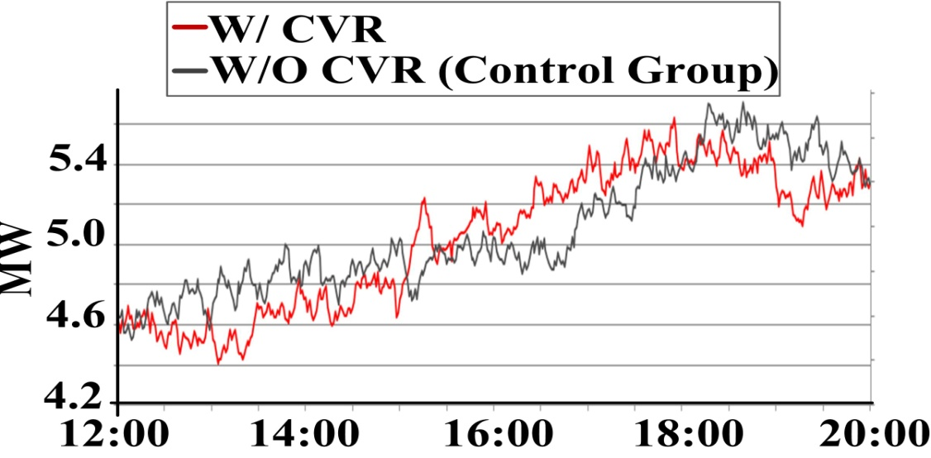
CVR Challenges
Existing approaches:
Comparison method
Easy and straightforward
Difficult to find a good control group
Regression method
Clear physical meaning
Linear model and regression error
Our solution:
Inspired by the nature of CVR
Model the load as a function of voltage
Calculate CVR factor from load-to-voltage sensitivity
No control group
No day-on/day-off tests
Robust to noise
[4] Z. Wang and J. Wang, "Review on Implementation and Assessment of Conservation Voltage Reduction," IEEE Transactions on Power Systems, vol. 29, no. 3, pp. 1306-1315, May 2014.

Slide 24
CVR: implementation
To implement CVR:
Open-loop VVC (w/o voltage feedback): change LTC tap position, line drop compensation, voltage spread reduction, CB-based reduction and home voltage reduction.
Disadvantages of open-loop VVC
the depth of voltage is limited
the control of all devices is not optimized (just based on local data)
cannot adapt to dynamic changes of distribution networks
Closed-loop VVC: take advantage of various measurements to determine the best (optimal) VVC actions during certain time periods.
Advantages of closed-loop VVC
optimal voltage reduction
optimal energy-saving effect
adaptive to dynamic system changes
[6] Z. Wang and J. Wang, "Review on Implementation and Assessment of Conservation Voltage Reduction," IEEE Transactions on Power Systems, vol. 29, no. 3, pp. 1306-1315, May 2014.

Slide 25
Data-driven Assessment of CVR
Practical System
Measurement Devices
CVR Factor Calculation
Load Model
Identified load model
_
+
Identification Algorithm

Slide 26
Load Model Identification
Exponential load model
Time-varying exponential load model
Model linearization
Mathematical model of input signal
Load-to-voltage sensitivity

Slide 27
Load Model Identification

Slide 28
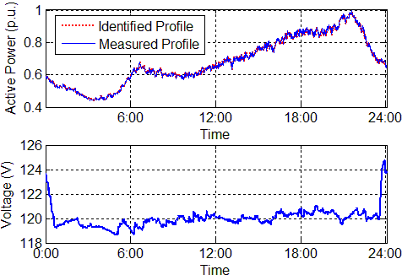
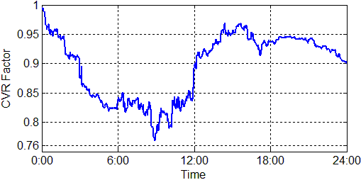
Data-driven Assessment of CVR
Example shown
One test day in June

Slide 29
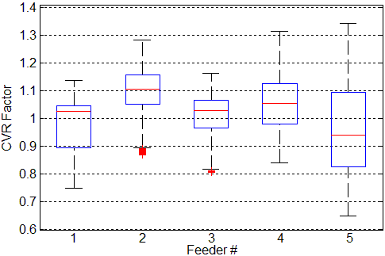
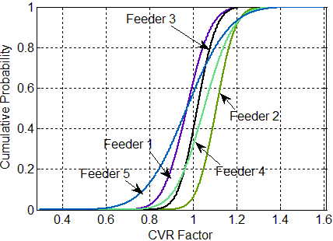
Data-driven Assessment of CVR
Summary of test results of a utility
Five test feeders
January 2012-December 2012
Which feeder has the best performance in terms of CVR factors?
Box plot of CVR factors of five test feeders
CDFs of CVR factors of five test feeders

Slide 30
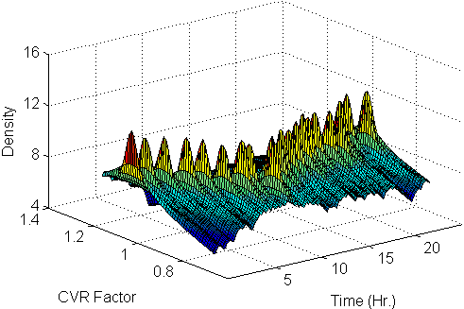
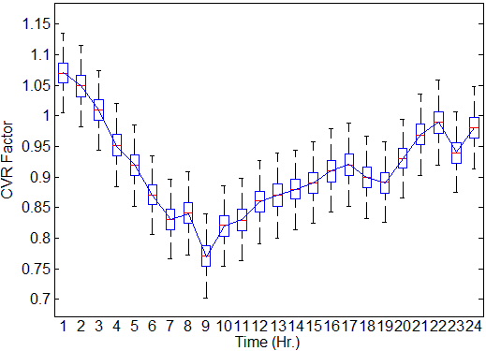
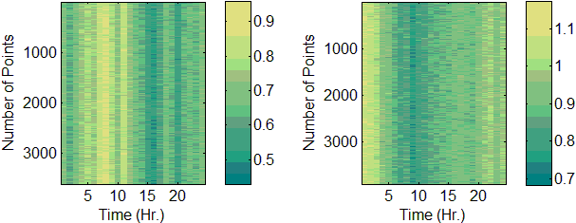
Data-driven Assessment of CVR
${CVR}_{f}$ in summer
${CVR}_{f}$ in summer
${CVR}_{f}$ in winter
${CVR}_{f}$ in summer

Slide 31
Topic: Rolling-Horizon VVO (centralized, w/o PV smart inverter)
Ref. [7] proposes a model predictive control (MPC)-based VVO technique considering the integration of distributed generators and load-to-voltage sensitivities.
The proposed model schedules optimal tap positions of LTC and switch status of CBs are obtained based on predictive output of wind turbines (WTs) and PV generators (PVs).
The exponential load model is used to capture the various load behaviors (Compared with previous efforts on VVO which used constant-power load model).
The uncertainties of model predication errors are taken into account in the proposed model.
A scenario reduction technique is applied to enhance a tradeoff between the accuracy of the solution and the computational burden.
[7] Z . Wang, J. Wang, B. Chen, M. M. Begovic and Y. He, "MPC-Based Voltage/Var Optimization for Distribution Circuits With Distributed Generators and Exponential Load Models," in IEEE Transactions on Smart Grid, vol. 5, no. 5, pp. 2412-2420, Sept. 2014.

Slide 32
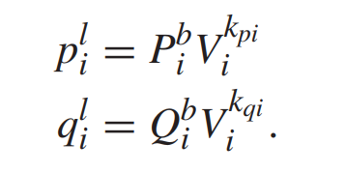
Load Models
Compared to constant-power load model, exponential load model (ELM) is more accurate in practice.
In fact, the $k_{pi}$ and $k_{qi}$ are related with load compositions (for constant power load model, $k_{pi}$=0, $k_{qi}=0$).
Tab.1 Load type and exponent values [7]
[7] Z . Wang, J. Wang, B. Chen, M. M. Begovic and Y. He, "MPC-Based Voltage/Var Optimization for Distribution Circuits With Distributed Generators and Exponential Load Models," in IEEE Transactions on Smart Grid, vol. 5, no. 5, pp. 2412-2420, Sept. 2014.

Slide 33
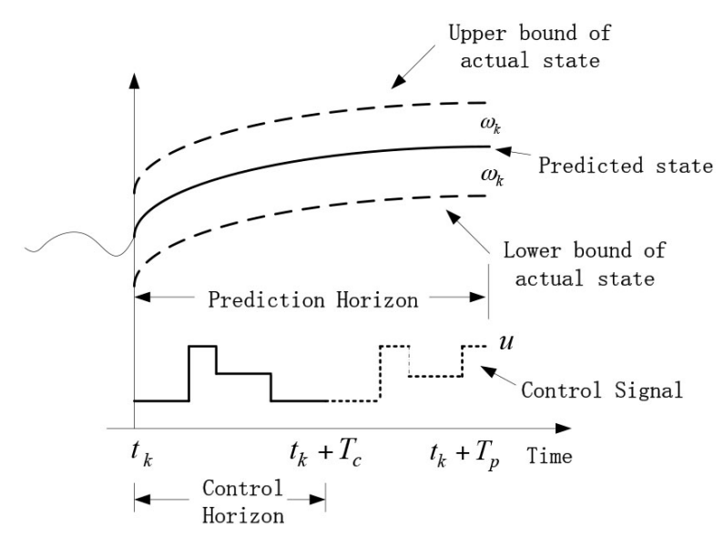
MPC Predictive Control
MPC refers to algorithms that solve:
A finite-horizon optimal control problem over the prediction horizon $T_{p}$
The obtained control variables are applied to the system over control horizon $T_{c}$, where $T_{c}≤T_{p}$
At the end of the control horizon, the rest of the predicted control variable are discarded and the entire procedure is repeated.
Fig.2 Demonstration of MPC [7]
[7] Z . Wang, J. Wang, B. Chen, M. M. Begovic and Y. He, "MPC-Based Voltage/Var Optimization for Distribution Circuits With Distributed Generators and Exponential Load Models," in IEEE Transactions on Smart Grid, vol. 5, no. 5, pp. 2412-2420, Sept. 2014.

Slide 34
VVO Formulation
In [7], the VVO problem is formulated as a stochastic MINLP
The objective function minimizes
the expectation of active power losses;
voltage deviation along the feeder during the prediction horizon.
The two objectives are equally weighted (can be changed by DSO)
$ω_{t}$ is the prediction error
The maximum voltage deviation of all nodes.
Active losses of the distribution network
Linear form of the DistFlow equations
[7] Z . Wang, J. Wang, B. Chen, M. M. Begovic and Y. He, "MPC-Based Voltage/Var Optimization for Distribution Circuits With Distributed Generators and Exponential Load Models," in IEEE Transactions on Smart Grid, vol. 5, no. 5, pp. 2412-2420, Sept. 2014.

Slide 35
VVO Formulation
The outputs of DG unit and capacitors are represented as negative loads.
It assumes outputs of DG units equal the predicted value plus the predicted values plus the predicted errors $ω$.
$ω$ belongs to an uncertainty set, which may vary with predicted values.
CBs output. $c_{i,t}$ represents the on/off status of the capacitor at node i during the time interval t.
$V_{s}$ represents the primary voltage of the transformer at the substation, which is assumed to be 1.0. p.u.. The secondary voltage is modeled as a function of the primary voltage.
The exponential load models are used to represents active and reactive load consumption.
$P_{i,t}^{b,pred},Q_{i,t}^{b,pred}$ change with a load profile which can be obtained by using short-term load forecasting techniques.
[7] Z . Wang, J. Wang, B. Chen, M. M. Begovic and Y. He, "MPC-Based Voltage/Var Optimization for Distribution Circuits With Distributed Generators and Exponential Load Models," in IEEE Transactions on Smart Grid, vol. 5, no. 5, pp. 2412-2420, Sept. 2014.

Slide 36
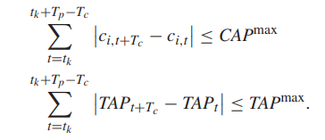
VVO Formulation
It indicates the voltage of each node should be within a certain range for proper operation of the distribution circuit, $ε$ is usually set to be 0.05.
The max number of daily switching operations of LTC and CBs are shown.
[7] Z . Wang, J. Wang, B. Chen, M. M. Begovic and Y. He, "MPC-Based Voltage/Var Optimization for Distribution Circuits With Distributed Generators and Exponential Load Models," in IEEE Transactions on Smart Grid, vol. 5, no. 5, pp. 2412-2420, Sept. 2014.

Slide 37
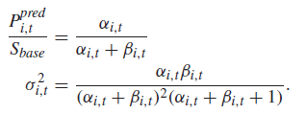
Prediction errors
Errors always exist in prediction models.
In [7], the beta distribution is used to calculate the predication errors for WTs and PVs. The beta function can be defined by two shape parameters $α$ and $β$, which models the occurrence of real power values x when a certain prediction value, $P_{i,t}^{pred}$ has been forecasted:
In [7], a normal distribution is used to represent the forecasting uncertainty of load consumption:
The mean value of the normal distribution is forecasted load
The standard deviation is set to be 2% of the expected load
All above distributions and parameters settings can be changed according to the available information of a system.
[7] Z . Wang, J. Wang, B. Chen, M. M. Begovic and Y. He, "MPC-Based Voltage/Var Optimization for Distribution Circuits With Distributed Generators and Exponential Load Models," in IEEE Transactions on Smart Grid, vol. 5, no. 5, pp. 2412-2420, Sept. 2014.

Slide 38
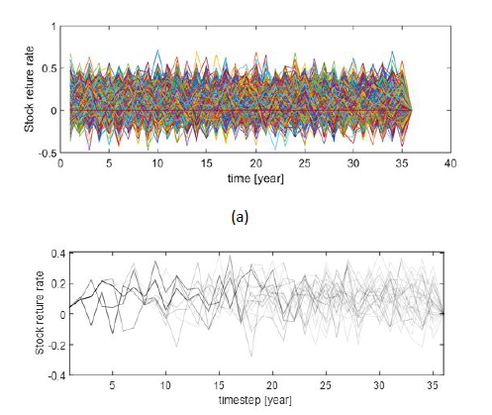
Scenario generation and reduction
Scenario generation:
Monte-Carlo simulation is run based on forecasted power and uncertain prediction errors to generate scenarios for DG outputs and load consumptions.
Scenario reduction:
In order to reduce the computation efforts, backward reduction method is implemented to reduce the number of scenarios while maintaining a good approximation of the system uncertainty.
Fig.3 Examples (a) scenario generation; (b) scenario reduction
[7] Z . Wang, J. Wang, B. Chen, M. M. Begovic and Y. He, "MPC-Based Voltage/Var Optimization for Distribution Circuits With Distributed Generators and Exponential Load Models," in IEEE Transactions on Smart Grid, vol. 5, no. 5, pp. 2412-2420, Sept. 2014.

Slide 39
EV and EEV
It is necessary to show how much improvement can be achieved if the stochastic prediction errors are taken into account in MPC.
The random error $ω$ is replaced by its expected value ${\overline{ω}}_{t}=E(ω_{k})$, and then the expected value problem (EV), which is a deterministic optimization can be defined as:
$$EV=min\sum_{t=t_{k}}^{t_{k}+T_{p}}{\left(ℓ_{t}\left({\overline{ω}}_{t}\right)+λ\left({\overline{ω}}_{t}\right)\right)}$$
Define the expected value solution as $\overline{x}$. The expected results of using the EV solution can be represented as
$$EEV=\frac{1}{N^{′}}\sum_{h=1}^{N^{′}}{\left(ℓ_{t}\left(\overline{x},ω^{h}\right)+λ\left(\overline{x},ω^{h}\right)\right)}$$
EEV measures the performance of $\overline{x}$. The $N^{′}$ is the number of scenario.
It can compare EEV and the objective value of the proposed MPC-VVO to see how the stochastic programming outperforms the deterministic programming.
[7] Z . Wang, J. Wang, B. Chen, M. M. Begovic and Y. He, "MPC-Based Voltage/Var Optimization for Distribution Circuits With Distributed Generators and Exponential Load Models," in IEEE Transactions on Smart Grid, vol. 5, no. 5, pp. 2412-2420, Sept. 2014.

Slide 40
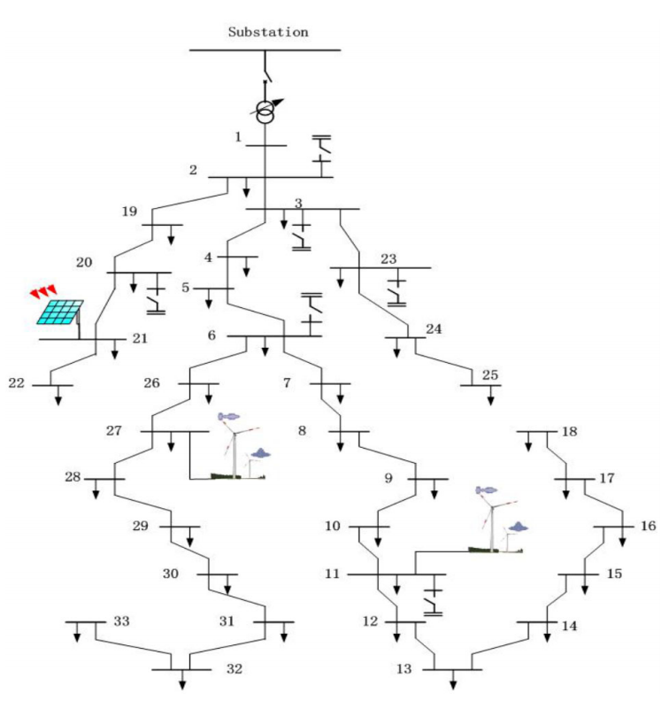
Case Study
The proposed methodology has been examined on the modified 33-bus radial distribution network.
Two WTs and one PV
Different types of loads
The substation transformer is with ±10% tap range.
Switched capacitors are installed at nodes 2, 3, 6, 11, 21 and 23 (30 kVAR).
Prediction horizon $T_{p}=6$ h
Control horizon $T_{c}=15$ min
100 generated scenarios
15 scenarios after reduction
Fig.3 Test distribution system [7]
[7] Z . Wang, J. Wang, B. Chen, M. M. Begovic and Y. He, "MPC-Based Voltage/Var Optimization for Distribution Circuits With Distributed Generators and Exponential Load Models," in IEEE Transactions on Smart Grid, vol. 5, no. 5, pp. 2412-2420, Sept. 2014.

Slide 41
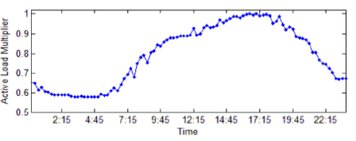
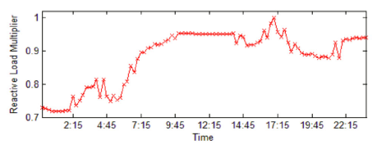
Case Study
All loads in the case study are represented by ELM, the load consumption of node i at time t can be represented as
The value of basic components $P_{i}^{b}$ and $Q_{i}^{b}$ can be found in [8], the exponents of each type of load.
Tab.2 Node type
The multipliers $M_{t}^{p}$ and $M_{T}^{q}$ (same for all nodes) are used to make the load profile change with time.
Fig.4 Load shape multiplier
[8] M. E. Baran and F. F. Wu, “Network reconfiguration in distribution systems for loss reduction and load balancing,” IEEE Trans. Power Del., vol. 4, no. 2, pp. 1401–1407, Apr. 1989.

Slide 42
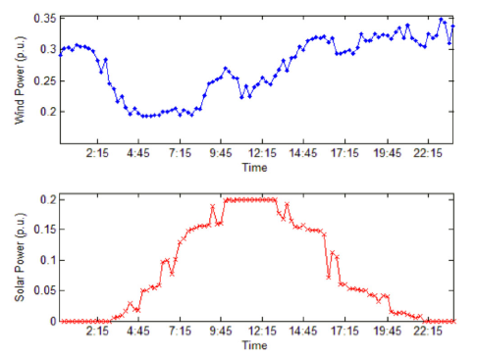
Case Study
Fig. 5 shows the normalized predicted wind and solar power outputs in the case study. The power base of the system is set to be 1 MVA.
Fig.5 Predicted wind and solar power
[7] Z . Wang, J. Wang, B. Chen, M. M. Begovic and Y. He, "MPC-Based Voltage/Var Optimization for Distribution Circuits With Distributed Generators and Exponential Load Models," in IEEE Transactions on Smart Grid, vol. 5, no. 5, pp. 2412-2420, Sept. 2014.

Slide 43
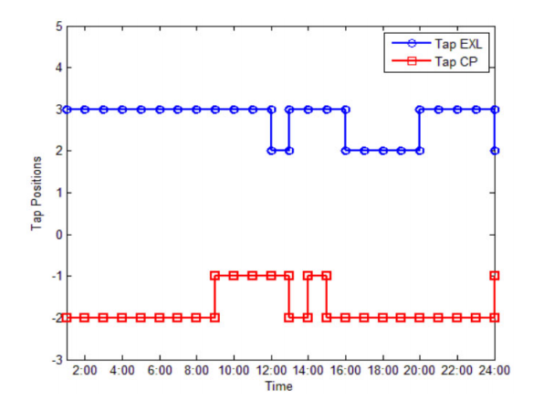
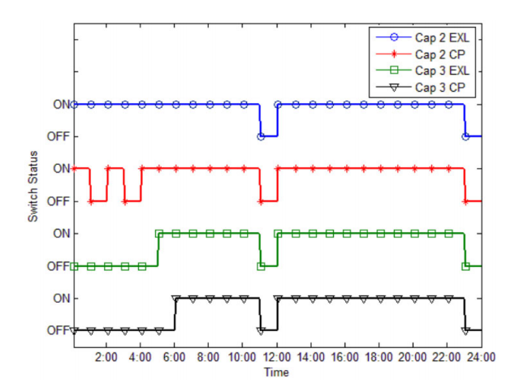
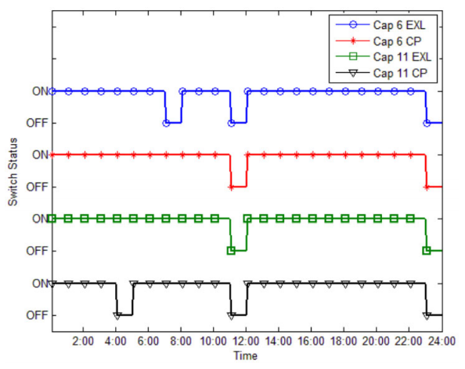
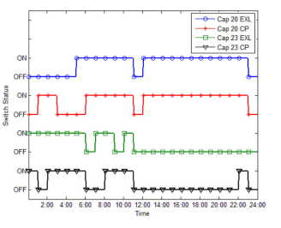
Numerical Results
Fig.6 Tap positions with EXL and CP
Fig.7 Switch status of CB2 and CB3 with EXL and CP
Different results of LTCs and CB for EXL model and CP model:
EXL: exponential model
CP: constant power model
Fig.8 Switch status of CB6 and CB11 with EXL and CP
Fig.9 Switch status of CB20 and CB23 with EXL and CP
[7] Z . Wang, J. Wang, B. Chen, M. M. Begovic and Y. He, "MPC-Based Voltage/Var Optimization for Distribution Circuits With Distributed Generators and Exponential Load Models," in IEEE Transactions on Smart Grid, vol. 5, no. 5, pp. 2412-2420, Sept. 2014.

Slide 44
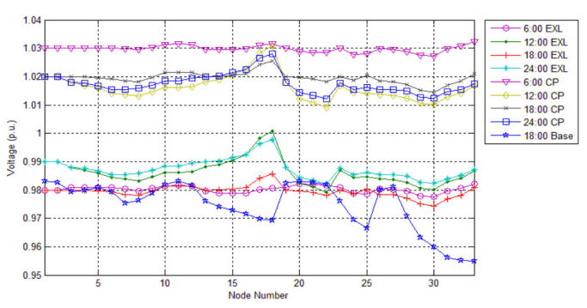
Numerical Results
Fig. 10 shows the voltages of all nodes for different cases. Base represents the voltages with DGs and ELM, but without OLTC and CBs.
Compared to base case, the proposed MPC-based VVO can largely improve the voltage profile.
The optimal voltage levels with CP model are relatively higher than those with ELM.
The reason is that losses are proportional to the square of the current, and the current of a constant-power load is inversely proportional to the voltage.
Fig.10 Voltage profiles of EXL, CP and Base cases
[7] Z . Wang, J. Wang, B. Chen, M. M. Begovic and Y. He, "MPC-Based Voltage/Var Optimization for Distribution Circuits With Distributed Generators and Exponential Load Models," in IEEE Transactions on Smart Grid, vol. 5, no. 5, pp. 2412-2420, Sept. 2014.
Notes:
The reason is that losses are proportional to the square of the current, and the current of a constant-power load is inversely proportional to the voltage

Slide 45
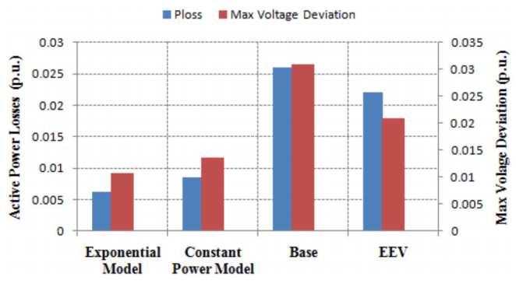
Numerical Results
Fig. 11 shows the active power losses and maximum voltage deviation of VVO with ELM, CP, EEV and base case.
Compared to base case, the proposed MPC-based VVO can
reduce the maximum voltage deviation by 65% and power losses by 77%.
Compared to EEV (deterministic model), the proposed MPC-based VVO can
reduce the maximum voltage deviation by 49% and power losses by 72%.
Fig.11 Active power losses and max voltage deviations
[7] Z . Wang, J. Wang, B. Chen, M. M. Begovic and Y. He, "MPC-Based Voltage/Var Optimization for Distribution Circuits With Distributed Generators and Exponential Load Models," in IEEE Transactions on Smart Grid, vol. 5, no. 5, pp. 2412-2420, Sept. 2014.
Notes:
The reason is that losses are proportional to the square of the current, and the current of a constant-power load is inversely proportional to the voltage

Slide 46
Topic: Multi-stage VVO (hierarchical, with PV smart inverters)
Ref. [8] proposes a novel three-stage robust inverter-based VVC (TRI-VVC) approach for high PV penetrated distribution networks.
Coordinating three different control stage from centralized VVC to local VVC to reduce energy loss and mitigate voltage deviation.
In the first stage, CBs and LTC are scheduled hourly in a rolling horizon.
In the second stage, PV inverters are dispatched in a short time-window.
In the third stage, PV inverters respond to real-time voltage violation through local droop controllers.
To address the uncertain PV output and load demand, a robust optimization model is proposed to optimize the first two stages while taking into account the droop voltage control support from the third stage.
[8] C. Zhang, Y. Xu, Z. Dong and J. Ravishankar, "Three-Stage Robust Inverter-Based Voltage/Var Control for Distribution Networks With High-Level PV," in IEEE Transactions on Smart Grid, vol. 10, no. 1, pp. 782-793, Jan. 2019.

Slide 47
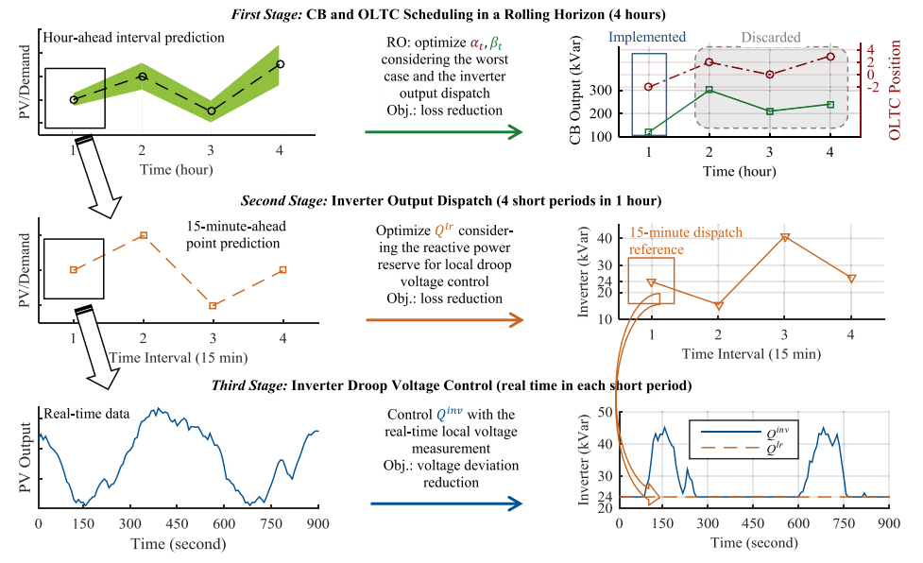
TRI-VVC
The TRI-VVC aims at robustly minimizing network energy losses and meanwhile maintaining secure voltages under fast and uncertain PV generation and load demand variations.
Fig.12 TRI-VVC strategy
[8] C. Zhang, Y. Xu, Z. Dong and J. Ravishankar, "Three-Stage Robust Inverter-Based Voltage/Var Control for Distribution Networks With High-Level PV," in IEEE Transactions on Smart Grid, vol. 10, no. 1, pp. 782-793, Jan. 2019.
Notes:
Stage I: The first stage aims at optimally scheduling CBs and an OLTC. In this stage, the PV generation and load demand intervals are predicted over a finite prediction horizon T (4 hours). But only the decision of the first hour is implemented, and the remaining is discarded. The first stage decision is optimized considering the worst case of PV output and demand.
Stage I: to Stage II: only the CBs and OLTC status for the current hour is implemented in the first stage, and the inverter dispatch is optimized again in the second stage according to uncertainty realization.
Stage II: . In the second stage, the PV inverters are dispatched to reduce network energy loss in a shorter period p, e.g., 15 minutes, as a recourse action for the first stage decision after the uncertainties are realized.
Stage II to Stage III: The optimized inverter output is also set as the reference point for the third stage.
Stage III: The third stage provides real-time reactive power support to alleviate the voltage violation if it occurs.

Slide 48
First Stage: CB and OLTC scheduling in rolling horizons (1-hour)
The first stage aims at optimally scheduling CBs and an OLTC.
The PV generation and load demand are predicted over a finite prediction horizon T (4 hours).
The hourly CB outputs and OLTC position are optimized for the whole horizon to minimize the energy loss while satisfying the voltage constraints.
Only the decisions (CBs and OLTC) of the first hour are implemented. The optimization procedure is rolled to benefit from more accurate PV output and load forecasting in coming future with shorter leading-time.
The inverter dispatch is optimized as a compensation operation under the worst case (PV output and demand) in the first stage. The inverter dispatch is optimized again in the second stage according to uncertainty realization.
Fig.12 TRI-VVC strategy: first stage
[8] C. Zhang, Y. Xu, Z. Dong and J. Ravishankar, "Three-Stage Robust Inverter-Based Voltage/Var Control for Distribution Networks With High-Level PV," in IEEE Transactions on Smart Grid, vol. 10, no. 1, pp. 782-793, Jan. 2019.
Notes:
Stage I: The first stage aims at optimally scheduling CBs and an OLTC. In this stage, the PV generation and load demand intervals are predicted over a finite prediction horizon T (4 hours). But only the decision of the first hour is implemented, and the remaining is discarded. The first stage decision is optimized considering the worst case of PV output and demand.
Stage I: to Stage II: only the CBs and OLTC status for the current hour is implemented in the first stage, and the inverter dispatch is optimized again in the second stage according to uncertainty realization.
Stage II: . In the second stage, the PV inverters are dispatched to reduce network energy loss in a shorter period p, e.g., 15 minutes, as a recourse action for the first stage decision after the uncertainties are realized.
Stage II to Stage III: The optimized inverter output is also set as the reference point for the third stage.
Stage III: The third stage provides real-time reactive power support to alleviate the voltage violation if it occurs.

Slide 49
Second Stage: Inverter output dispatch (15-min)
In the second stage, the PV inverters are dispatched to reduce network energy in a loss in a shorter period, e.g., 15-min, as a recourse action for the first stage decision after the uncertainties are realized.
More accurate 15-min ahead predictions of PV generation and demand are used.
The inverter reactive power output is optimized and implemented for each 15-min period within the current hour.
The optimized inverter output is also set as the reference point for the third stage.
Fig.12 TRI-VVC strategy: second stage
[8] C. Zhang, Y. Xu, Z. Dong and J. Ravishankar, "Three-Stage Robust Inverter-Based Voltage/Var Control for Distribution Networks With High-Level PV," in IEEE Transactions on Smart Grid, vol. 10, no. 1, pp. 782-793, Jan. 2019.
Notes:
Stage I: The first stage aims at optimally scheduling CBs and an OLTC. In this stage, the PV generation and load demand intervals are predicted over a finite prediction horizon T (4 hours). But only the decision of the first hour is implemented, and the remaining is discarded. The first stage decision is optimized considering the worst case of PV output and demand.
Stage I: to Stage II: only the CBs and OLTC status for the current hour is implemented in the first stage, and the inverter dispatch is optimized again in the second stage according to uncertainty realization.
Stage II: . In the second stage, the PV inverters are dispatched to reduce network energy loss in a shorter period p, e.g., 15 minutes, as a recourse action for the first stage decision after the uncertainties are realized.
Stage II to Stage III: The optimized inverter output is also set as the reference point for the third stage.
Stage III: The third stage provides real-time reactive power support to alleviate the voltage violation if it occurs.

Slide 50
Third Stage: Inverter droop voltage control (real-time)
The first two stages minimize the loss while satisfying the voltage constraints under the uncertainties in 1-hour to 15-min periods. However, within each 15-min period, the PV output can still dramatically vary under special conditions (transient cloud movements), where the voltage limits may be violated.
Thus, the third stage provides real-time (1-sec) reactive support for the possible voltage violations. A droop controller is designed as:
If a real-time local voltage is out of the allowed operational limits due to significant PV output changes, the inverters generate or consume reactive power linearly with the voltage changes.
If the voltage is still within the allowed limits, the inverter output is kept to the value optimized from the second stage.
Fig.12 TRI-VVC strategy: third stage
[8] C. Zhang, Y. Xu, Z. Dong and J. Ravishankar, "Three-Stage Robust Inverter-Based Voltage/Var Control for Distribution Networks With High-Level PV," in IEEE Transactions on Smart Grid, vol. 10, no. 1, pp. 782-793, Jan. 2019.
Notes:
Stage I: The first stage aims at optimally scheduling CBs and an OLTC. In this stage, the PV generation and load demand intervals are predicted over a finite prediction horizon T (4 hours). But only the decision of the first hour is implemented, and the remaining is discarded. The first stage decision is optimized considering the worst case of PV output and demand.
Stage I: to Stage II: only the CBs and OLTC status for the current hour is implemented in the first stage, and the inverter dispatch is optimized again in the second stage according to uncertainty realization.
Stage II: . In the second stage, the PV inverters are dispatched to reduce network energy loss in a shorter period p, e.g., 15 minutes, as a recourse action for the first stage decision after the uncertainties are realized.
Stage II to Stage III: The optimized inverter output is also set as the reference point for the third stage.
Stage III: The third stage provides real-time reactive power support to alleviate the voltage violation if it occurs.

Slide 51
Math Formulation
The proposed TRI-VVC is formulated as the following optimization model:
Objective function is to minimize the total energy loss in the current prediction horizon T.
$τ$ is the time length of the first stage (hour)
$α_{i,j,t}$ is the binary on/off decision of jth unit of the CB at node i during period t.
$β_{t}$ is the integer position of the LTC during period t.
Allowed maximal changing time for the CB switch for the current T.
Allowable maximal times for the LTC position changes during the whole horizon T and each period t.
[8] C. Zhang, Y. Xu, Z. Dong and J. Ravishankar, "Three-Stage Robust Inverter-Based Voltage/Var Control for Distribution Networks With High-Level PV," in IEEE Transactions on Smart Grid, vol. 10, no. 1, pp. 782-793, Jan. 2019.

Slide 52
Math Formulation
It calculated the reactive power dispatch capacity of the inverter in the second stage $Q_{i,t}^{disp}$.
Then, the dispatch range of the inverter reactive power output $Q_{i,t}^{lr}$ is defined.
PV output and load demand $P/Q_{i,t}^{PV/D}$can vary within the predicted lower and upper bound.
CB reactive power output $Q_{i,t}^{CB}$ with on/off decision $α_{i,j,t}$.
Substation voltage $V_{1,t}$ with LTC position $β_{t}$.
The voltage magnitude of each node $V_{i,t}$ must be kept within the allowed deviation range.
[8] C. Zhang, Y. Xu, Z. Dong and J. Ravishankar, "Three-Stage Robust Inverter-Based Voltage/Var Control for Distribution Networks With High-Level PV," in IEEE Transactions on Smart Grid, vol. 10, no. 1, pp. 782-793, Jan. 2019.

Slide 53
Math Formulation
The active power flow $P_{i,t}$ is limited with the line capacity.
Fully linearized Dist-Flow model (will be introduced in the future):
Active, reactive power flow and voltage relationships for two neighboring buses.
Linear calculation for the complex power losses.
Divide the complex power flow into pieces.
[8] C. Zhang, Y. Xu, Z. Dong and J. Ravishankar, "Three-Stage Robust Inverter-Based Voltage/Var Control for Distribution Networks With High-Level PV," in IEEE Transactions on Smart Grid, vol. 10, no. 1, pp. 782-793, Jan. 2019.

Slide 54
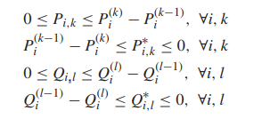
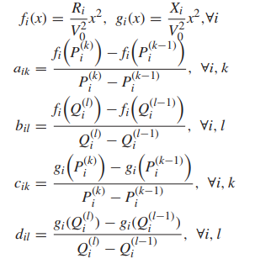
Math Formulation
Each piecewise power flow variable can vary only within its corresponding interval.
$P_{i,k}^{∗}$ and $Q_{i,k}^{∗}$ are the negative piecewise power flow variable and they are utilized to calculate the power loss when the power flow is in the reverse direction.
The calculation of all the linear equation slopes.
[8] C. Zhang, Y. Xu, Z. Dong and J. Ravishankar, "Three-Stage Robust Inverter-Based Voltage/Var Control for Distribution Networks With High-Level PV," in IEEE Transactions on Smart Grid, vol. 10, no. 1, pp. 782-793, Jan. 2019.

Slide 55
Robust Optimization
The robust optimization (RO) first searches for the worst case of uncertainty realization then optimizes the objective under the worst case.
Compared to the conventional stochastic optimization, the RO has three major advantages:
It does not need a probability distribution function or scenario-based data to model the uncertainty.
It achieves a robust solution according to the worst case instead of a solution based on the optimal expectation.
RO can achieve high computational efficiency, since it utilizes uncertainty sets to model uncertainties instead of a large number of scenarios which are utilized in stochastic optimization.
[8] C. Zhang, Y. Xu, Z. Dong and J. Ravishankar, "Three-Stage Robust Inverter-Based Voltage/Var Control for Distribution Networks With High-Level PV," in IEEE Transactions on Smart Grid, vol. 10, no. 1, pp. 782-793, Jan. 2019.

Slide 56
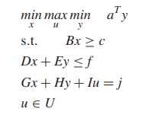
Robust Optimization
The RO model for the proposed TRI-VVC strategy can be formulated in the following compact matrix form
The constraints will be grouped into different forms.
The CBs status $α$ and the LTC position $β$ are the first stage decision variable which are “here-and-now” decision variable.
The inverter output $Q^{lr}$ is the “wait-and-see” decision variable of the second stage.
The maximization in this “min-max-min” form is to search for the worst case of the uncertainty where the largest energy loss would occur, i.e., the uncertainty variables are optimized to some certain values leading to the highest energy loss.
[8] C. Zhang, Y. Xu, Z. Dong and J. Ravishankar, "Three-Stage Robust Inverter-Based Voltage/Var Control for Distribution Networks With High-Level PV," in IEEE Transactions on Smart Grid, vol. 10, no. 1, pp. 782-793, Jan. 2019.

Slide 57
Case Study
In this paper, a balanced three-phase 33-bus radial distribution network with CBs, an OLTC and PVs installed is used in the case study.
The power flow of this system is assumed as balanced three-phase flow.
Each CB has 10 capacitor units of 30 kVAR.
In the test, $V_{0}=1$ p.u., $V^{Tap}=0.005$ p.u., the allowed operational voltage range $\left[\underline{V_{i}},\overline{V_{i}}\right]=\left[0.95,1.05\right]$.
The critical voltage range used in the PV inverter droop control $\left[\underline{V^{cri}},\overline{V^{cri}}\right]=\left[0.94,1.06\right]$.
[8] C. Zhang, Y. Xu, Z. Dong and J. Ravishankar, "Three-Stage Robust Inverter-Based Voltage/Var Control for Distribution Networks With High-Level PV," in IEEE Transactions on Smart Grid, vol. 10, no. 1, pp. 782-793, Jan. 2019.

Slide 58
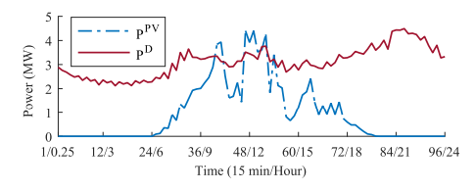
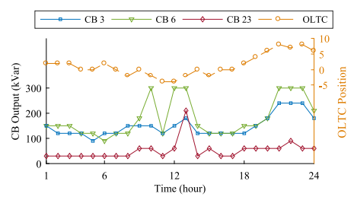
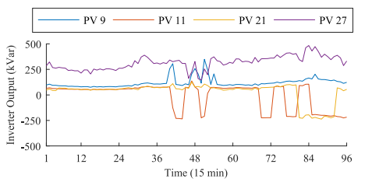
Case Study
The proposed TRI-VVC is applied for 24 hours. The 24-hour rolling horizon predictions of the PV output and the load demand are shown as below.
Fig.13 24-hour PV output and load demand profile
The 24-hour simulation results are shown.
Fig.14 24-hour first stage decisions
Fig.15 24-hour second stage decisions
[8] C. Zhang, Y. Xu, Z. Dong and J. Ravishankar, "Three-Stage Robust Inverter-Based Voltage/Var Control for Distribution Networks With High-Level PV," in IEEE Transactions on Smart Grid, vol. 10, no. 1, pp. 782-793, Jan. 2019.

Slide 59
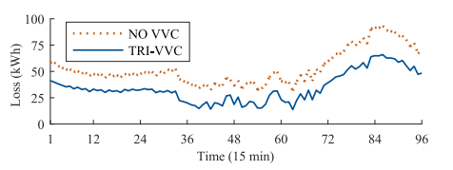
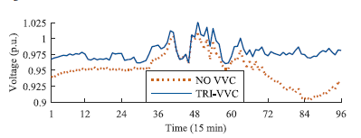
Case Study
The energy loss of the system and the voltage of Bus 11 for all the short periods are shown.
For each period, the loss with the TRIVVC is much less than the loss without VVC.
Compared to the voltage without VVC, the TRI-VVC can keep the bus voltage in each period within the allowed range.
Fig.16 24-hour total loss results
Fig.17 24-hour voltage results at Bus 11
[8] C. Zhang, Y. Xu, Z. Dong and J. Ravishankar, "Three-Stage Robust Inverter-Based Voltage/Var Control for Distribution Networks With High-Level PV," in IEEE Transactions on Smart Grid, vol. 10, no. 1, pp. 782-793, Jan. 2019.

Slide 60
Case Study
The proposed TRI-VVC strategy is compared with a conventional single-stage centralized VVC (SSC-VVC) strategy.
* In this conventional method, the operating decisions of the CBs, the OLTC and the inverters are optimized together with rolling point predictions where only mean values are predicted.
The TRI-VVC strategy can achieve effectively robust solutions against the uncertainties to avoid voltage violation while carrying out relatively low energy loss.
[8] C. Zhang, Y. Xu, Z. Dong and J. Ravishankar, "Three-Stage Robust Inverter-Based Voltage/Var Control for Distribution Networks With High-Level PV," in IEEE Transactions on Smart Grid, vol. 10, no. 1, pp. 782-793, Jan. 2019.

Slide 61
Summary
VVC helps the operator mitigate dangerously low or high voltage conditions by suggesting required action plans for all VVC devices.
VVO optimally manages voltage levels and reactive power to achieve more efficient grid operation by reducing system losses, peak demand or energy consumption or a combination of multi-objectives.
CVR reduces customer voltages along a distribution circuit to reduce electricity demand and energy consumption.

Slide 62
References
[1] Office of Electricity Delivery and Energy Reliability, “Voltage and VAR Control Impact Analysis Approach”, U.S. Department of Energy, [online]: https://www.smartgrid.gov/files/Distribution_System_Energy_Efficiency_17Nov11.pdf
[2] Ding, Fei, et al. Photovoltaic impact assessment of smart inverter volt-var control on distribution system conservation voltage reduction and power quality. No. NREL/TP-5D00-67296. National Renewable Energy Lab.(NREL), Golden, CO (United States), 2016.
[3] Q. Li, Y. Zhang, T. Ji, X. Lin and Z. Cai, "Volt/Var Control for Power Grids With Connections of Large-Scale Wind Farms: A Review," in IEEE Access, vol. 6, pp. 26675-26692, 2018.
[4] K. Warner, and R. Willoughby, National Assessment of CVR-Preliminary Results from DOE’s CVR Initiative, IEEE Smart Grid Webinar, Sep. 11, 2014.
[5] Schneider, Kevin P., et al. Evaluation of conservation voltage reduction (CVR) on a national level. No. PNNL-19596. Pacific Northwest National Lab.(PNNL), Richland, WA (United States), 2010.
[6] Z. Wang and J. Wang, "Review on Implementation and Assessment of Conservation Voltage Reduction," IEEE Transactions on Power Systems, vol. 29, no. 3, pp. 1306-1315, May 2014.
[7] Z . Wang, J. Wang, B. Chen, M. M. Begovic and Y. He, "MPC-Based Voltage/Var Optimization for Distribution Circuits With Distributed Generators and Exponential Load Models," in IEEE Transactions on Smart Grid, vol. 5, no. 5, pp. 2412-2420, Sept. 2014.
[8] C. Zhang, Y. Xu, Z. Dong and J. Ravishankar, "Three-Stage Robust Inverter-Based Voltage/Var Control for Distribution Networks With High-Level PV," in IEEE Transactions on Smart Grid, vol. 10, no. 1, pp. 782-793, Jan. 2019.

Slide 63
Thank you!

